Slide 1
Introduction to Excel
Basic Excel Training – MO-200 Aligned
Notes:
Welcome learners; outline the session and emphasize hands-on practice.

Slide 2
Learning Objectives
Navigate the Ribbon, tabs, and Quick Access Toolbar
Differentiate workbooks vs worksheets and manage sheets
Open, save, and export files (XLSX, PDF)
Understand cells, rows, columns, ranges, and the formula bar
Notes:
Explain mapping to MO-200 objectives.

Slide 3
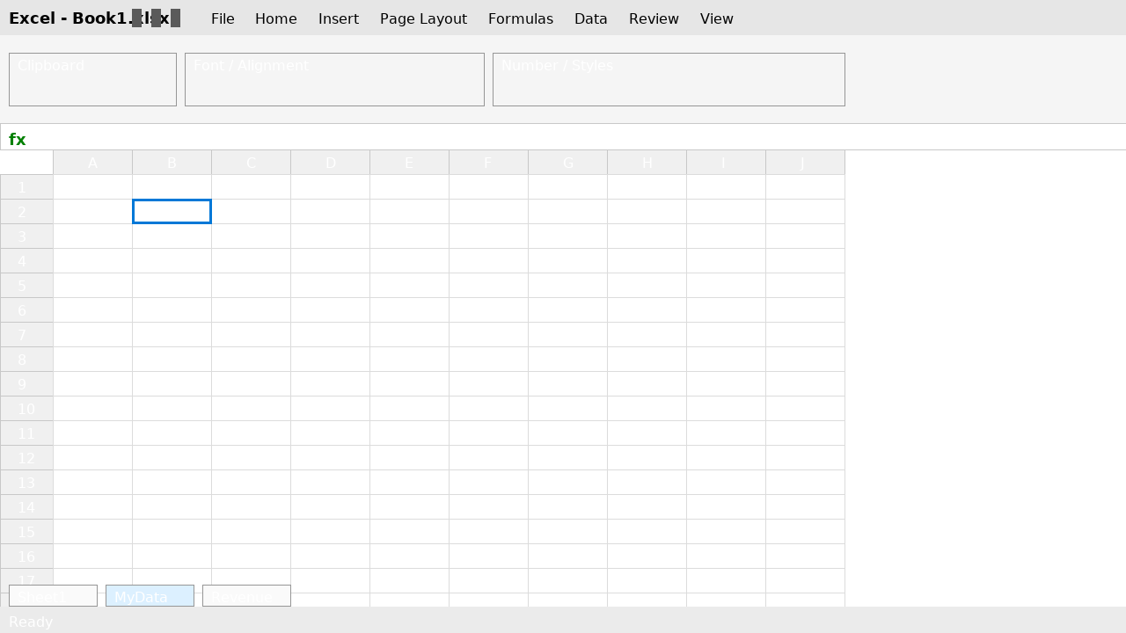
Tour the Interface
Identify: Ribbon tabs, groups, formula bar, grid, sheet tabs.
Notes:
Point to each UI area in the mock image. Optional: annotate live in class.

Slide 4
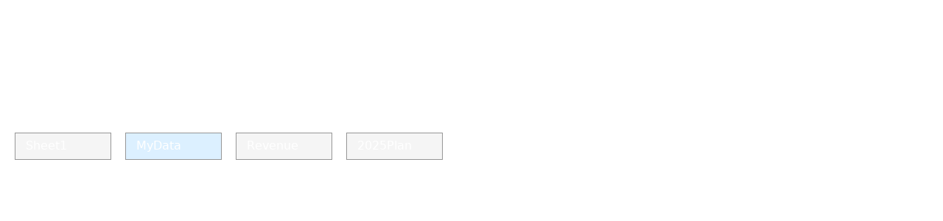
Worksheets vs Workbooks
A workbook contains multiple worksheets. Rename, add, and delete sheets.
Notes:
Ask learners to add a sheet and rename it to 'MyData'.

Slide 5
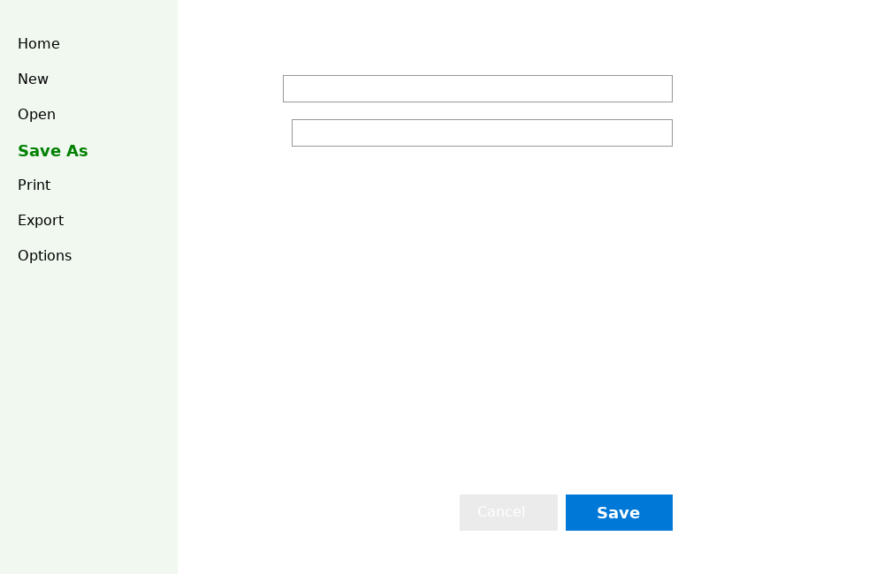
Saving Your Work (Save As)
Use File > Save As or F12. Choose Excel Workbook (*.xlsx) or export to PDF.
Notes:
Demonstrate filename best practices, versions, and locations.

Slide 6
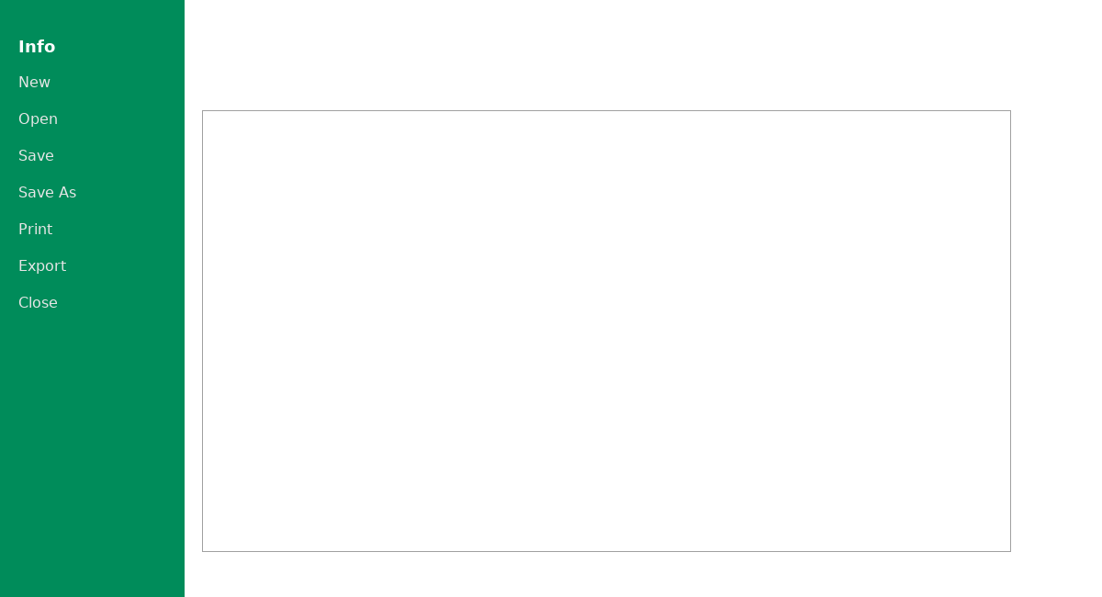
Backstage View (File tab)
Access Info, New, Open, Save, Print, Export.
Notes:
Discuss protecting workbooks and document properties.

Slide 7

Quick Access Toolbar (QAT)
Customize QAT to include Save, Undo, Redo, and frequently used commands.
Notes:
Show how to customize the QAT for faster workflow.

Slide 8
Practice Task
1) Create a new workbook (Ctrl+N)
2) Rename Sheet1 to 'MyData' and add another sheet 'Summary'
3) Type your name in A1, today’s date in B1 (Ctrl+;)
4) Save as MyFirstWorkbook.xlsx (Ctrl+S)
5) Export to PDF: File > Export > Create PDF/XPS
Notes:
Walk around (or check screens) to ensure each step is complete.

Slide 9
Common Mistakes & Tips
• Mistake: Confusing workbook vs worksheet → Tip: File vs tab
• Mistake: Not saving frequently → Tip: Ctrl+S often; enable AutoSave if using OneDrive
• Mistake: Losing files → Tip: Use organized folders; include date/version in filenames
Notes:
Share your own file-naming convention; encourage consistent habits.

Slide 10
Summary & Next Steps
You can now navigate Excel, manage sheets, and save/export files.
Next module: Data Entry & Formatting — input types, formatting, and number styles.
Notes:
Preview Module 2 and assign pre-reading: open the Budget lab starter.

